Slide 1
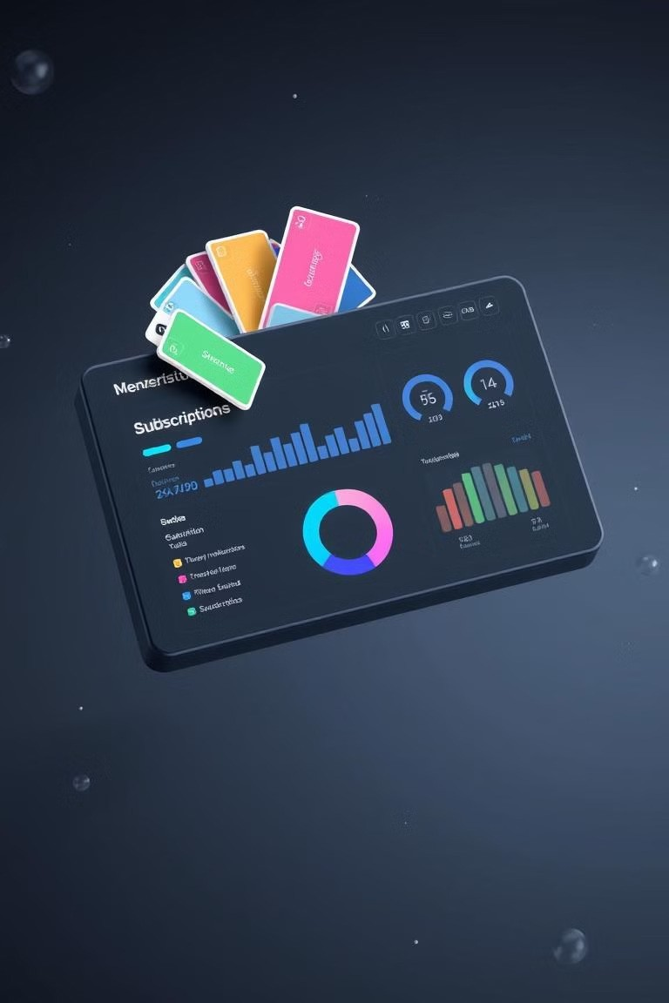
FinSync - A Subscription, Membership, and EMI Tracker
A Comprehensive Database Solution for Managing Digital Subscriptions, Memberships and EMI Tracking.
Group 6 : Shruti Sen, Veda Sawant, Pratiksha Mohod, Gagan CM, Jeet Sharma

Slide 2

Problem Statement
In today's subscription-driven world, individuals often struggle to manage multiple digital subscriptions, memberships, and warranties across various platforms. This leads to missed cancellations, accidental renewals, and unnecessary expenses. The lack of a centralized system for tracking, analyzing, and managing these recurring commitments prevents users from optimizing their financial decisions, staying organized, and maintaining control over their spending. A streamlined solution is essential to address these challenges and empower users to manage their subscriptions efficiently.

Slide 3
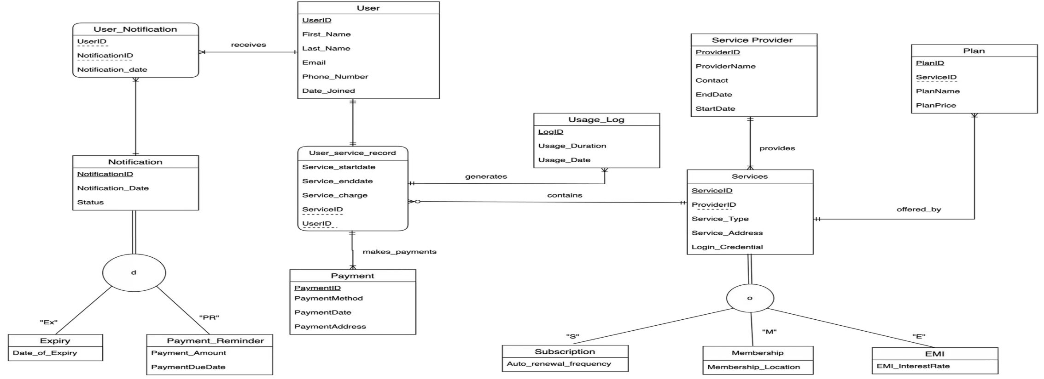
Entity Relationship Diagram

Slide 4
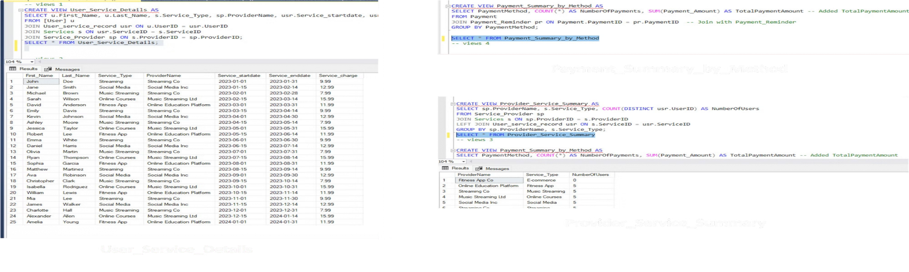
Views

Slide 5
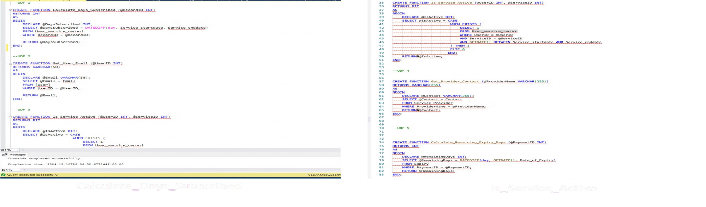
User Defined Functions

Slide 6
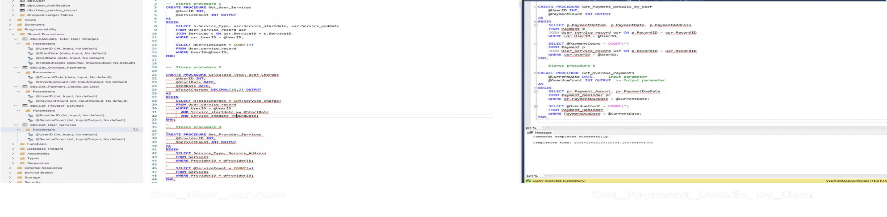
Stored Procedures

Slide 7
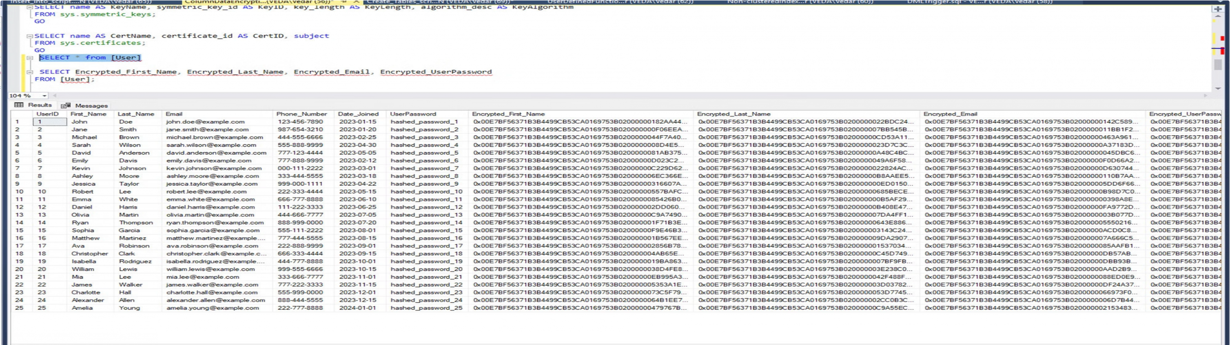
Column Data Encryption

Slide 8
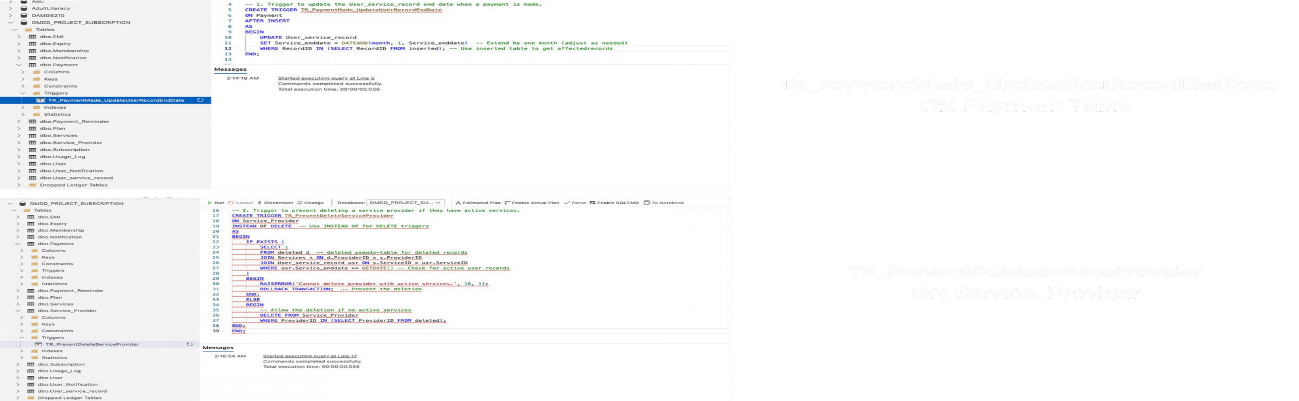
Triggers

Slide 9
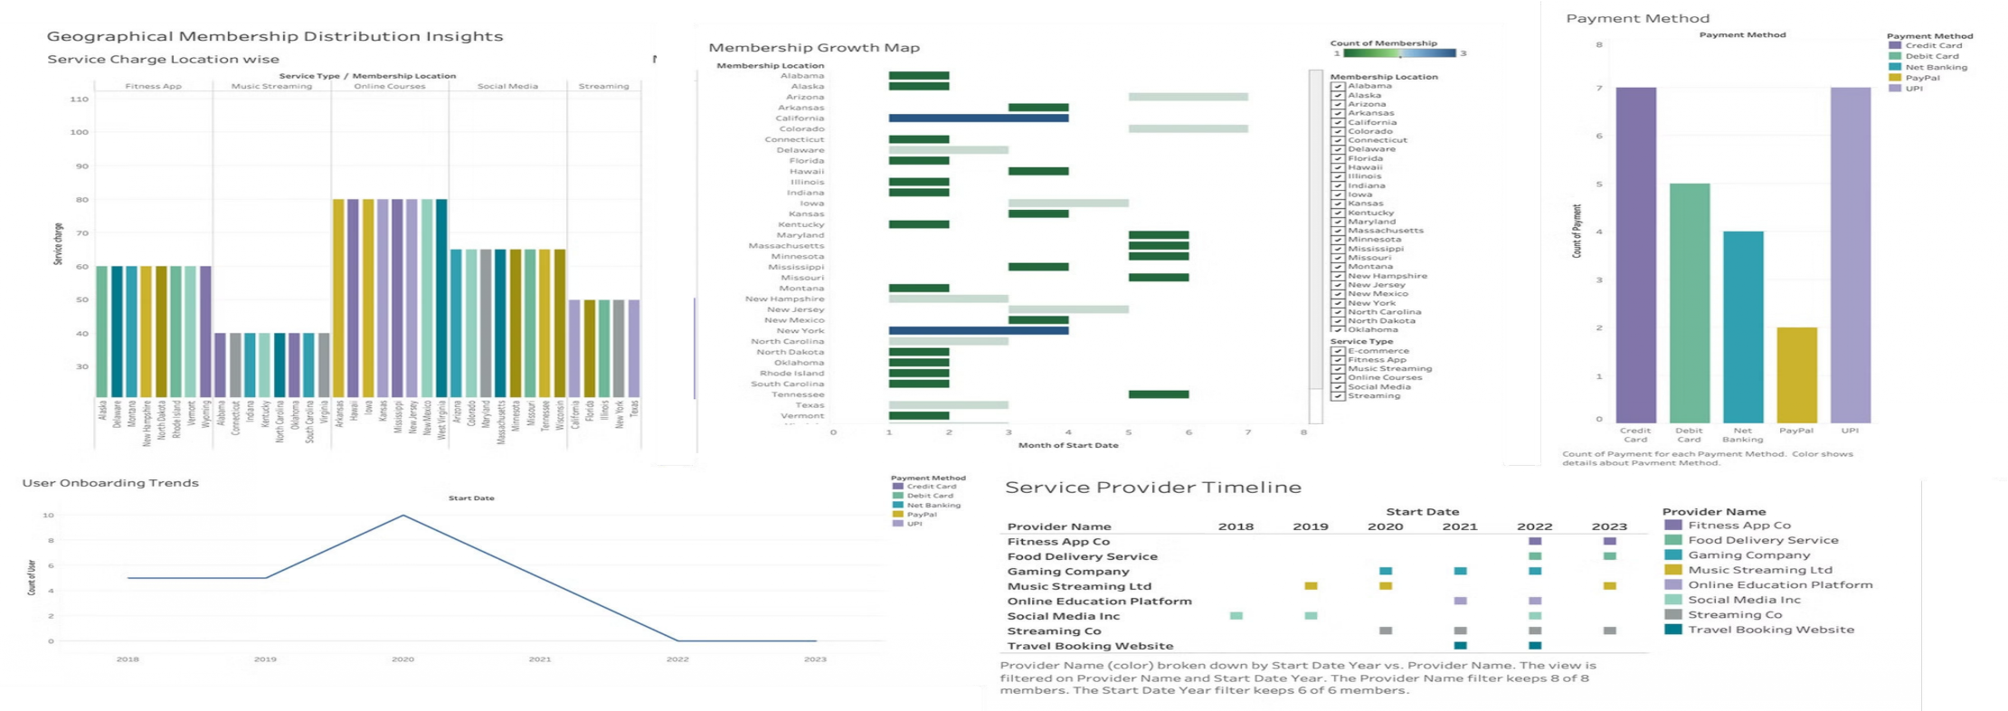
Data Visualisation

Slide 10
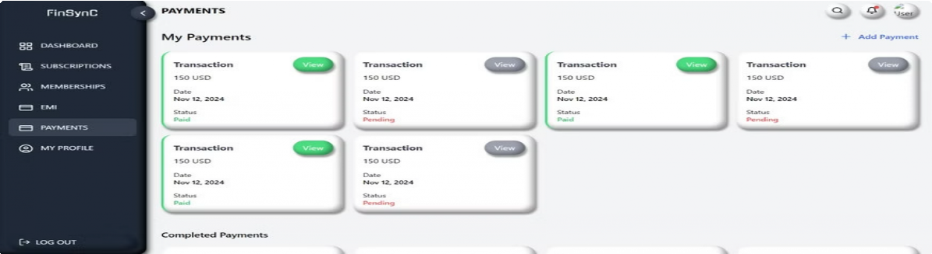
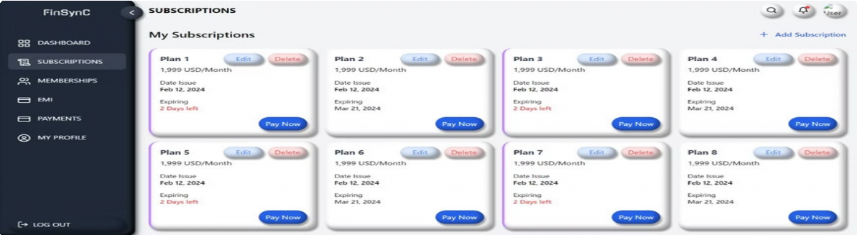
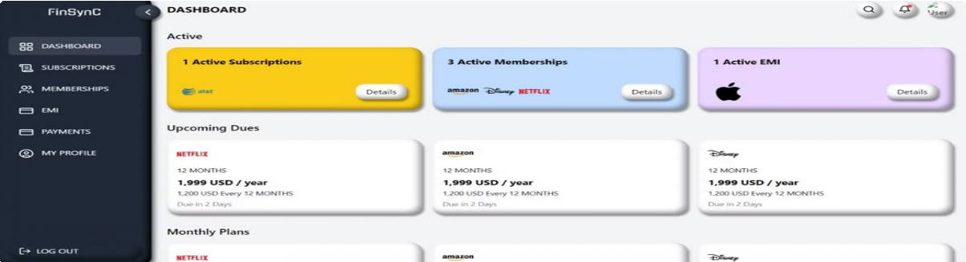
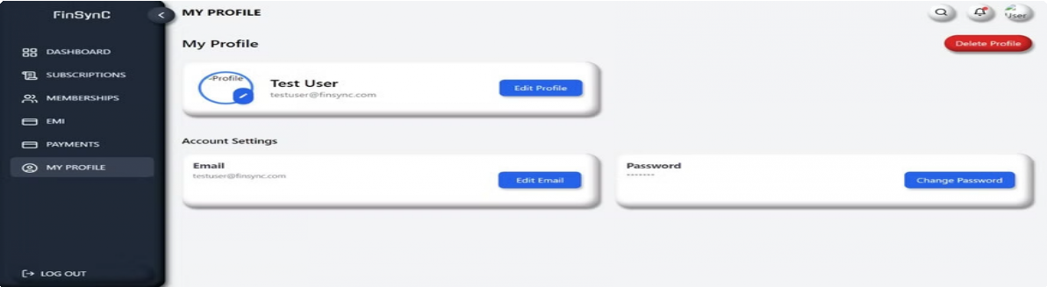
UI Screenshots

